Slide 1
Predicate Logic
Dr. Priyadarshan Dhabe
Ph.D (IIT Bombay), Professor,
Department of Information Technology

Slide 2
What is a Logic?
Logic:- is a science of reasoning. It defines representation, Manipulation and uses of real world facts. (Knowledge).
Logic:-The formal, systematic study of the principles of valid inference and correct reasoning (Ref:-Penguin Encyclopedia)
Aristotle –pioneered this field by codifying “Right Thinking”

Slide 3
Components of a Logic System
Syntax Rules- how to represent a fact in a valid manner using symbols?
Semantic Rules- How to interpret a represented fact?
Inference Rules- How to generate new and valid facts from existing facts?
A set of symbols- Used to represent real world facts.

Slide 4
Properties of Logic systems
Consistency :- No theorem (proof) of the system contradicts to another.
Soundness:-which means that the system's rules of proof will never allow a false inference from a true premise (basis/ argument). If a system is sound and its axioms are true then its theorems are also guaranteed to be true.
Completeness:-which means that there are no true sentences in the system that cannot, at least in principle, be proved in the system.

Slide 5
Propositional Logic
A Logic system already Known to you. Also called as sentential logic.
Proposition- is a sentence having truth values either “True” or “False”.

Slide 6
Problems with Propositional Logic(PL).
Assume following propositions.
  Tommy is a dog. Represented with “P”
  Moti is a dog. Represented with “Q”
Consider these representations only, P and Q. It is very difficult to find the commonality between “Tommy” and “Moti”.
Lack of expressiveness. Not every real world fact can be expressed in PL concisely (brief).
Representation lack focus on objects and their relationship.

Slide 7
Predicate Logic Introduction
Also called as “First order logic”, “Quantificational logic”, “First order predicate calculus”-wikipedia
First order refers to arguments of predicate are objects e.g red(Ball)
(Red- predicate, Ball is an object)
Higher order logic- arguments of a predicate can be predicates

Slide 8
Predicate Logic Introduction
What is a predicate?
Any sentence describes objects and their properties, classes and relationships.
Predicate is a part of sentence describing properties, classes and relationships of objects.
E.g. This Ball is Red.
(Red- predicate, Ball is an object)

Slide 9
Representing Facts in
Predicate Logic (informal way)
Write predicate outside the bracket ( ) and objects inside the bracket.
This ball is red.
red (Ball).
Ram is brother of Sham
  brother (Ram, Sham)
Sham defeated Hari and Ram
  defeated(Sham, Hari, Ram)
A predicate can have n objects or of n-arity
n>=0.
unary
binary
Ternary

Slide 10
General form
pqrst (A,B, C)
Objects
involved
Relationship, Class
Or
Property

Slide 11
Represent following simple facts in predicate logic
P. S. Dhabe is a professor.
Students appeared for exam.
Train is late. Late(Train)
A and B played chess.
Sky is blue.
A, B and C are project group members.

Slide 12
Relationship between Proposition and Predicate
Proposition= Predicate+ Objects involved in the fact

Slide 13
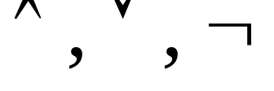

Components Of Predicate Logic
Set of Objects (Object Constants)
Set of functions (Function Constants)
Set of Relations (Relation Constants)
Connectives ( )
Delimiters (, ), [, ], seperator ,
Quantifiers ( )
Have a closer look at Syntax and Semantics.

Slide 14
Syntax of Objects
These are alphanumeric strings.
They either starts with a Capital letter or a number.
e.g. EifelTower,
Exam,
12box,
Ab,
Are valid Object representations in (PL)

Slide 15
Semantics of Objects
They can physical objects like box or pen.
They can be abstract entities like number 7 & Л.
They can be fictional entities like- “Santa Claus”

Slide 16
Syntax of Functions
These are alphanumeric strings always begins with a Capital letter.
These are the computable functions allowed to be used and called as “Skolem Functions”, due to logician Thoralf Skolem [1920].
e.g Father(x), x- object variable
This function returns name of the father of x so that we can write
congratulated(y, Father(x))

Slide 17
Semantics of Functions
A function can be of n-arity and it maps n objects into another objects.
e.g Childs(y) will return all the child names of object y.
Note:-Typographical conventions used here are not universal.

Slide 18
Syntax of Relations
Relation can be-
  property and object-Class relationship.
These are alphanumeric strings always begin with small case letters.
A relation constant is also called as a “predicate”. (Formal Definition)
defeated( Ram, Sham)

Slide 19
Semantics of Relations
Each relation will have arities.
Objects can participate in arbitrary number of relations.
A relation with arity 1 is called as “property” or A “object-class” relationship.
red(Ball) bird(crow)
They can have zero objects.
e.g. There is raining.
raining( ) or simply raining

Slide 20
Syntax Rules in predicate Logic
Talks about “How to write a valid WFF?”.
True and False (represented as T and F) are valid WFF.
(They are called as distinguished Atoms).
2. Atom or Atomic formula is a valid WFF.
“A predicate followed by n objects (n>=0) in parenthesis separated by comma” is called as Atom or Atomic formula.
playedchess(A, B) – is “Atomic” Formula
playedchess(A, B)^ winner(B) – “Composite” Formula

Slide 21
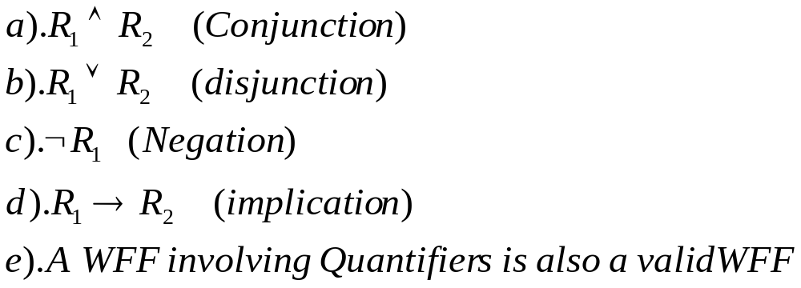
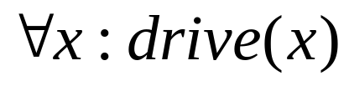

Syntax Rules in predicate Logic
3. If R₁ and R₂ are valid WFF then following are also WFF
4. There are no other WFF

Slide 22
Truth Table for Implication
A | B | A→B
T | T | T
T | F | F
F | T | T
F | F | T
What is “interpretation” of a formula?

Slide 23

Predicate calculus formulas (PCF) and Knowledge
PCF can be used to represent “Knowledge” that an agent has about the world.
Knowledge base:- A set of such wffs is called as knowledge base.
If a formula w is in then we say that agent “Knows” w, or more appropriately agent “believes” in w.

Slide 24
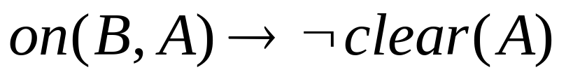
Example of Knowledge base
On (A, Floor)
On (B, A)
B
On (C, Floor)
A
C
clear (B)
Floor
clear ( C )
Blocks World Domain
Knowledge base

Slide 25
Quantification
Is a process that specify “quantity” of objects involved in a Fact in abstract/ general way. Mostly “at least one” or “all”.
This can be done using “Quantifiers”.
There are two types of Quantifiers
    Universal Quantifier.
    Existential Quantifier.

Slide 26

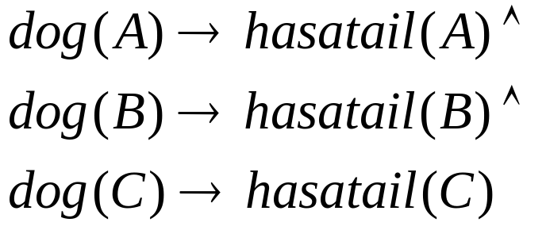
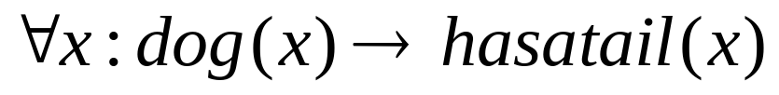
Universal Quantifiers (UQ)
Suppose we want to say that every object in the domain has a certain property or participated in a relation. If the domain is finite ( 3dogs A, B and C), we want to represent “every dog has a tail” . It can be represented using conjunction as
But if the domain is infinite we can not list all of them
Such situation is handled with a (UQ)
A UQ is used to represent “for all” and “every” phrases.

Slide 27
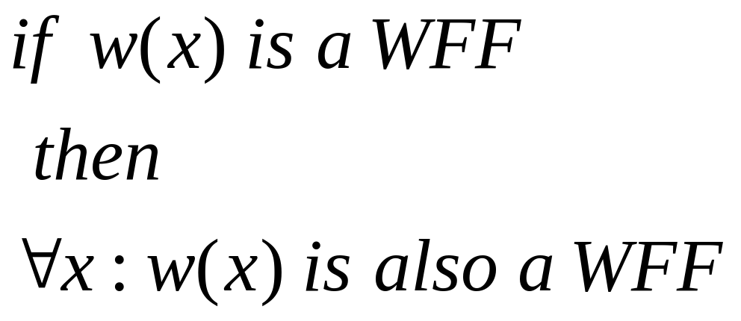
Syntax rule using UQ
Where x-is a object variable NOT an Object

Slide 28

“Truth value” of wff with Universal quantifiers
Above WFF is “TRUE” if it has a value “TRUE” for all the objects x in that domain.

Slide 29
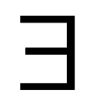
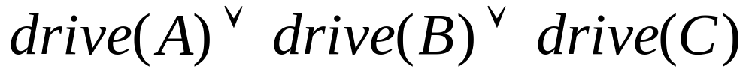
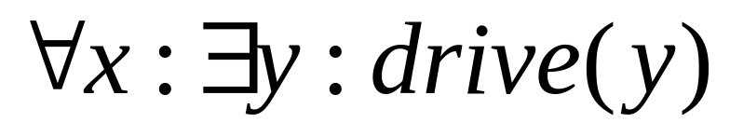
Existential Quantifier
Suppose we want to say that “at least one” object has a certain property. It can be handled using “disjunction” in finite domain.
Assume a finite domain of 3 persons A, B and C. We want to represent a fact “ at least one person can drive”.
In infinite domain an Existential Quantifier is used
Set-subset relationship?

Slide 30
“Truth value” of wff with Existential quantifiers
Above WFF is “TRUE” if it has a value “TRUE” for “at least one object” x in that domain.

Slide 31
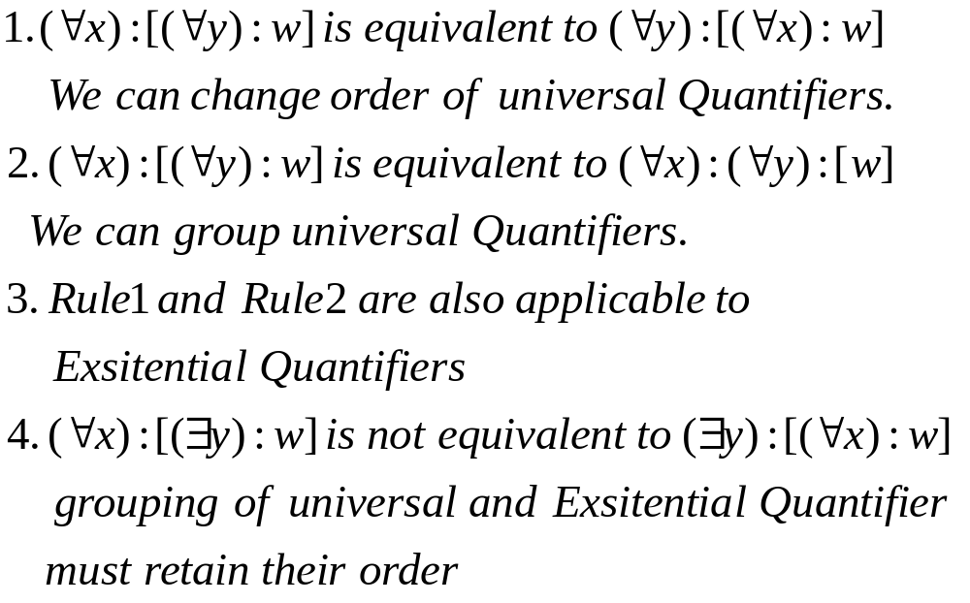
Some Rules about Quantifiers
Matrix
prefix

Slide 32
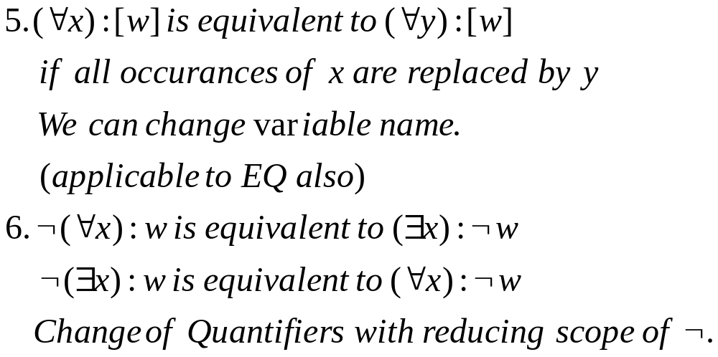
Some Rules about Quantifiers

Slide 33
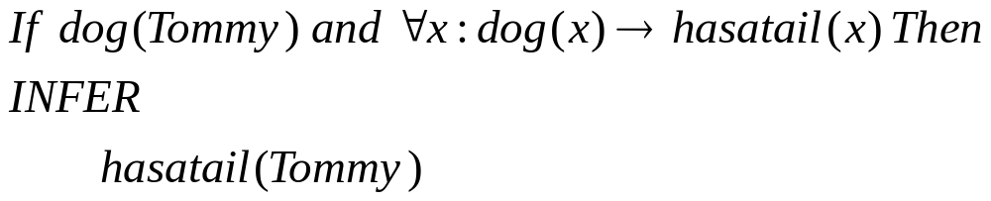
Inference Rules in Predicate Logic
Modus-ponen ( LATIN mode that affirms/state/asserts)
If P and P→Q are given
Then infer Q

Slide 34
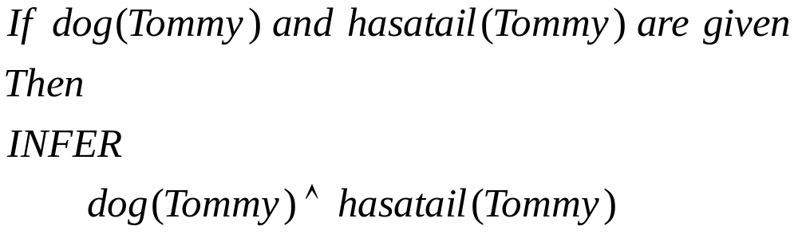
Inference Rules in Predicate Logic
2. (AND ^ Introduction)
IF P and Q are given then Infer
P^Q

Slide 35
Inference Rules in Predicate Logic
3. (Commutativity of ^)
IF P ^ Q is given then Infer
Q^P

Slide 36
Inference Rules in Predicate Logic
4. (^ Elimination)
IF P ^ Q is given then Infer
(either Q ) or (either P)

Slide 37
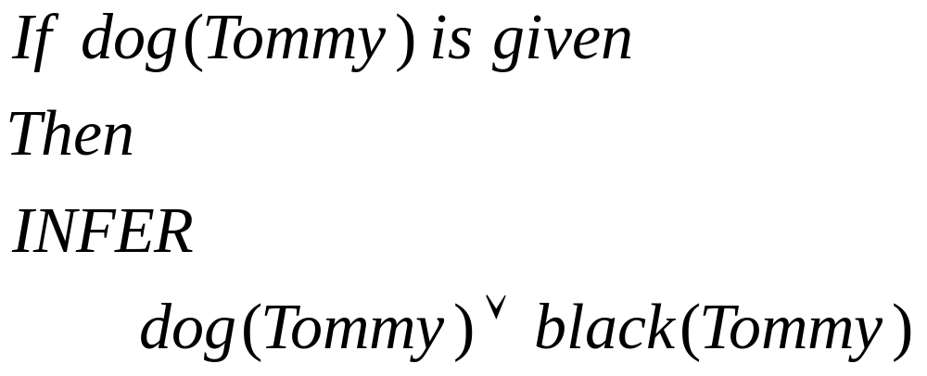
Inference Rules in Predicate Logic
5. ( V Introduction)
IF P is given
then Infer
P v Q

Slide 38
Inference Rules in Predicate Logic
6. ( ⌐ Elimination)
IF ⌐(⌐ P) is given
then Infer
P

Slide 39
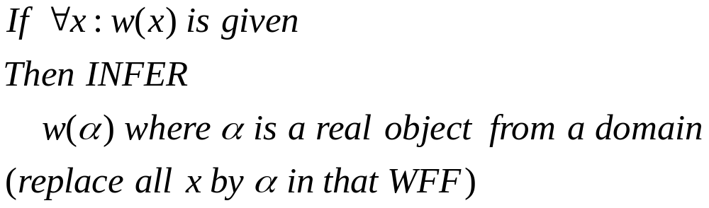
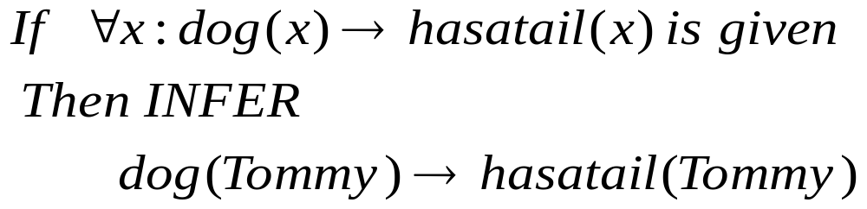
Inference Rules in Predicate Logic
7. ( Universal Instantiation UI)
General to specific

Slide 40
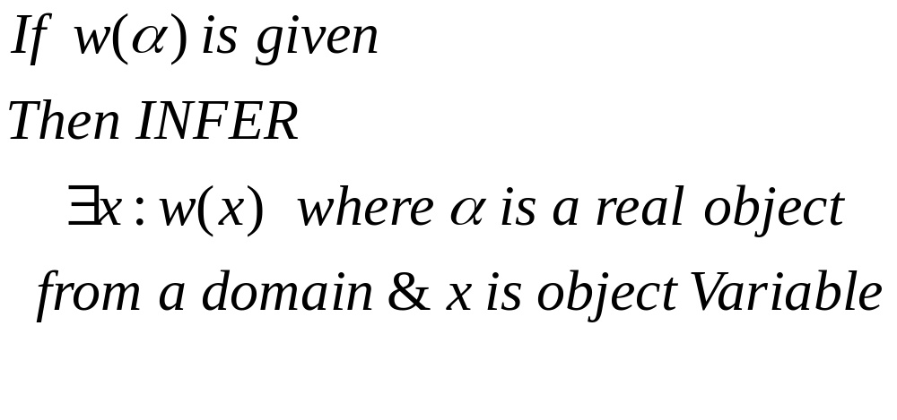
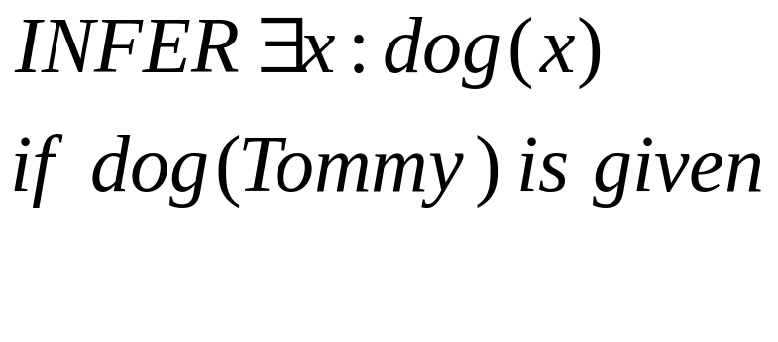
Inference Rules in Predicate Logic
8. ( Existential Generalization EG)
Specific to General

Slide 41
ISA Hierarchy
How to represent Class- subclass and instance relationships Explicitly?
Isa- predicate is used to represent Class- subclass relationship like.
Arguments to the isa predicate are “Class labels”.
Instance-predicate is used to represent object and class relationship explicitly.
Arguments to the instance predicate are object and class label.
  isa (Mammal, Animal)
  isa (Human, Mammal)
Not Objects
instance (Tommy, Dog)

Slide 42



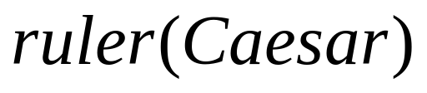
Representing more facts in Predicate Logic
1. Marcus was a man.
(Tense is ignored)
2. Marcus was Pompeian.
(Not:-Pompeii, an ancient city of southern Italy southeast of Naples. Founded in the sixth or early fifth century b.c., it was a Roman colony by 80 b.c. and became a prosperous port and resort with many noted villas, temples, theaters, and baths. Pompeii was destroyed by an eruption of Mount Vesuvius (volcano) in a.d. 79.)
3. All Pompeian’s were Romans.
4. Caesar was a ruler

Slide 43
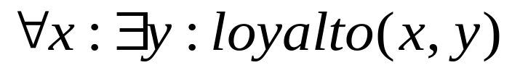
Representing more facts in Predicate Logic
5. All Romans were either loyal to Caesar or hated him.
6. Everyone is loyal to someone.
7. People only try assassinate rulers they are not loyal to.
8. Marcus tried to assassinate Caesar.

Slide 44
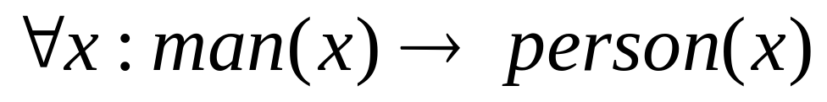
Representing more facts in Predicate Logic
9. Every man is a person.
Suppose we want to prove that “Marcus was not
loyal to Caesar”. A Human expert can prove this
in following way.

Slide 45

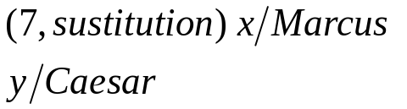
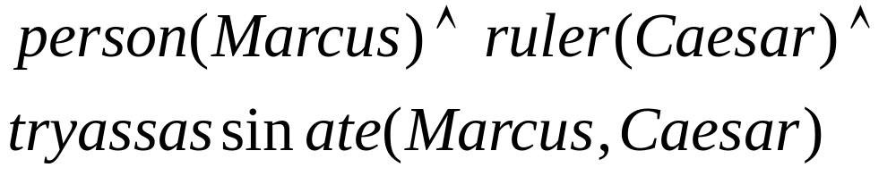






NULL

Slide 46
Problems in automating the proofs
Suppose a machine has to prove a statement that “Marcus was not loyal to Caesar” and having knowledgebase represented using WFF in predicate logic. e.g a WFF
Problems
1.System will not be efficient due to “Conjunctions”
2. Conjunction forces system to think more and thus requires more efforts.
3. Quantifiers add-up the same effect.
Solution :- A clause form

Slide 47
What is a Clause?
A clause is fact represented without “Conjunction” and “Quantifiers”.
A fact represented using single WFF in predicate logic can be converted into multiple clauses.
These Clauses are called “Horn Clauses”
(Logician Alfred Horn, 1951)

Slide 48
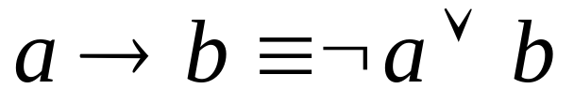
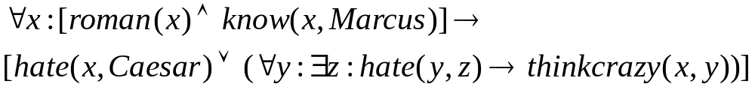
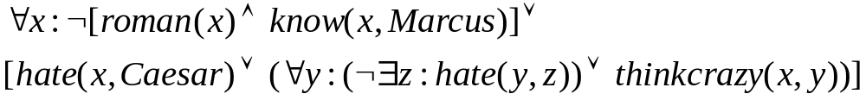
Converting a Fact into clause form.
Rule-1. Convert implication into their equivalent using rule
“All Romans who know Marcus either hate Caesar or think that anyone who hates anyone is a crazy”.

Slide 49
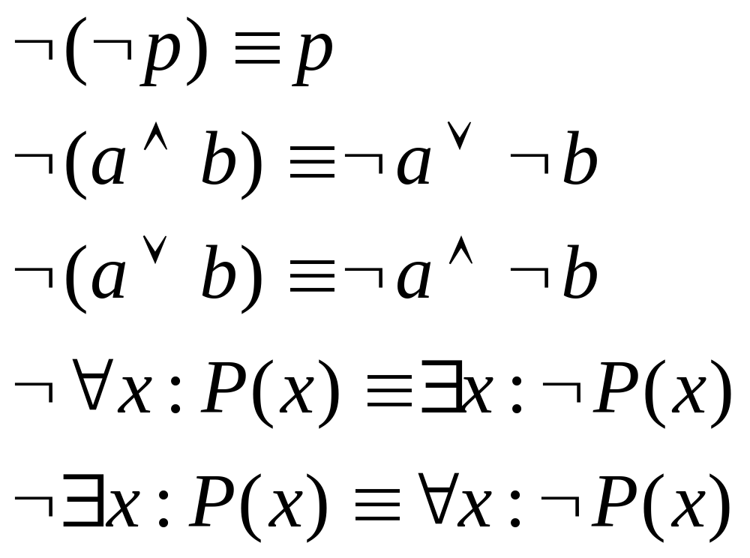
Converting a Fact into clause form.
Rule-2:- Reduce the scope of negation to a single term using the above rules
deMorgan’s Law
Standard correspondence between quantifiers

Slide 50
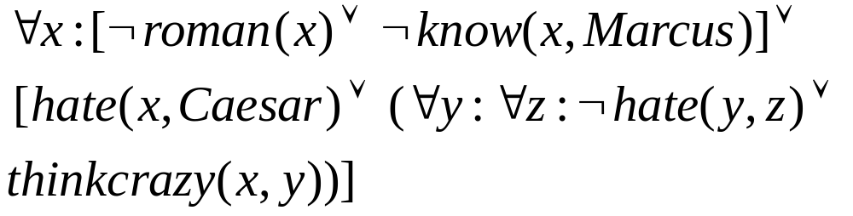
By applying Rule 2, above fact will be changed to
Correspondence between quantifiers
deMorgan’s law

Slide 51
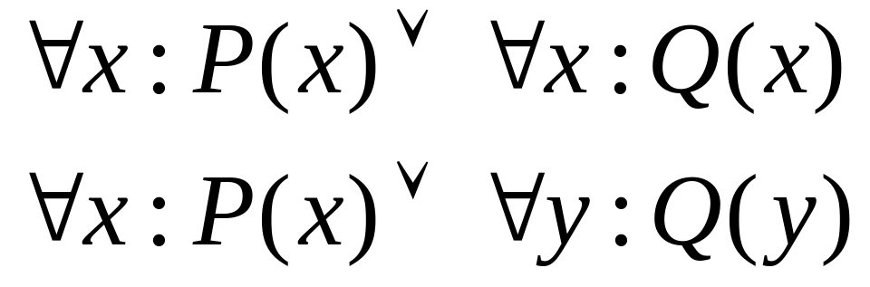
Converting a Fact into clause form.
Rule-3:- Standardize variables so that each quantifier binds a unique variable. e.g.
Scope of x

Slide 52
Rule 3- is not applicable to this fact since each quantifier binds a single variable.

Slide 53
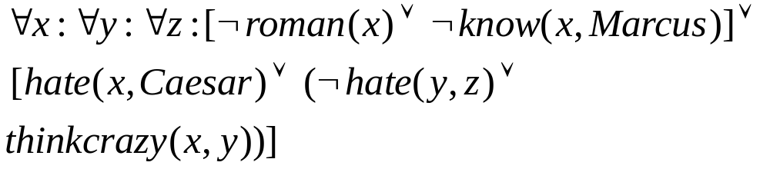
Converting a Fact into clause form.
Rule-4:- Move all the quantifiers to the left of formula without changing their relative order. This is possible since there is no conflict among variable names.
After application of Rule-4 to above fact it will be changed to

Slide 54
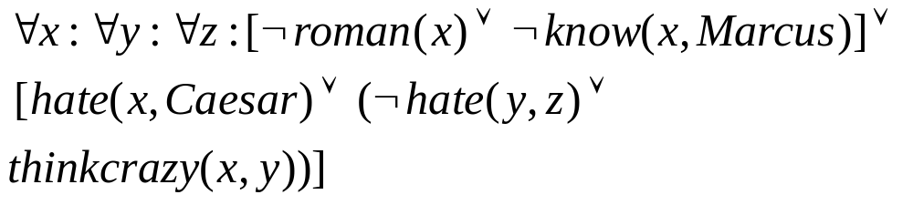
At this point formula is said to be in Prenex normal form, containing prefix of quantifiers followed by matrix.
prefix
Matrix

Slide 55
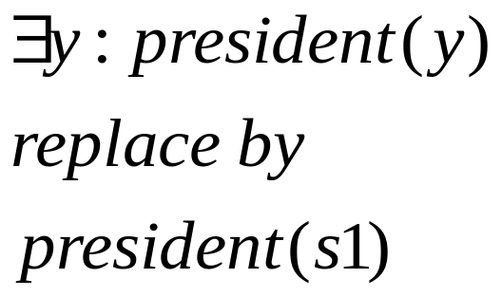
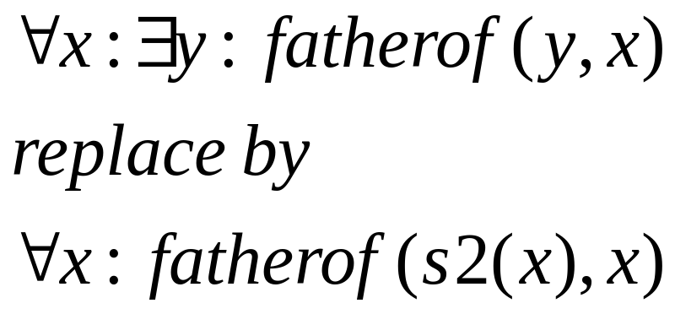
Converting a Fact into clause form.
Rule-5:- Eliminate existential quantifiers using “Skolem Functions” as follows.
Where s1 is a function with no arguments and that returns a value that satisfies president.

Slide 56
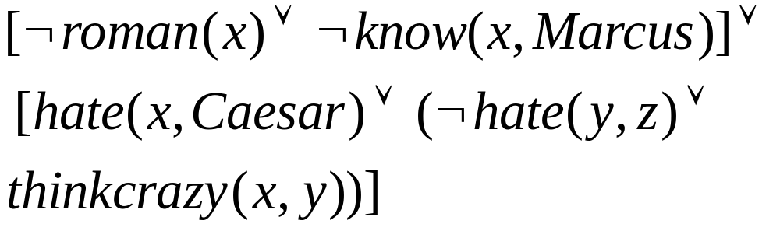
Converting a Fact into clause form.
Rule-6:- Drop the prefix. At this point all the remaining variables are universally quantified and any proof procedure can assume that each variable it sees is universally quantified.
After applying rule 6

Slide 57
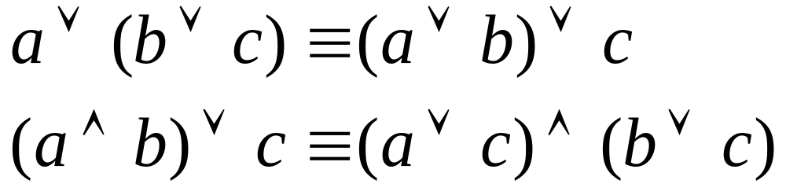
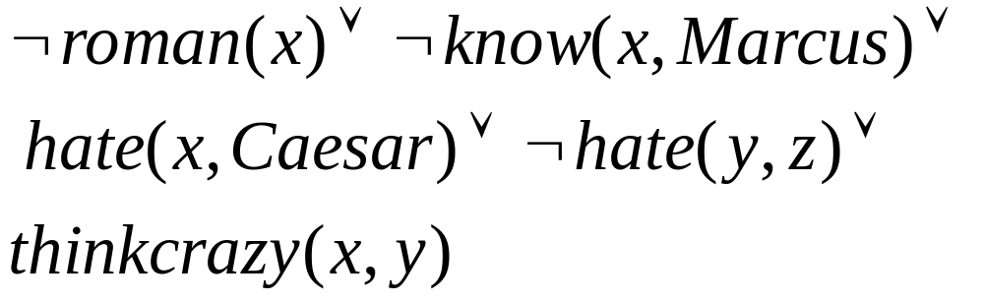
Converting a Fact into clause form.
Rule-7:- Convert the matrix into conjunction of disjuncts (CNF) and remove the parenthesis. Following properties can be useful here.
Associative
Distributive
Since there is no “AND” operator in our case thus remove the parenthesis.

Slide 58
Converting a Fact into clause form.
Rule-8:- Create a separate clause corresponding to each conjunct. A WFF is true if all the clauses generated from it are true. The set of facts represented with WFF and set of clauses are equivalent.
In our example there is no AND operator thus it leads to only one clause.

Slide 59
Converting a Fact into clause form.
Rule-9:- Standardize the variables such that each clause refers to different variable. Use following fact if necessary
In our case there is only one clause thus there is no need to apply this rule.
Clause Form

Slide 60
Problem-1
Convert above fact into Clause form.

Slide 61
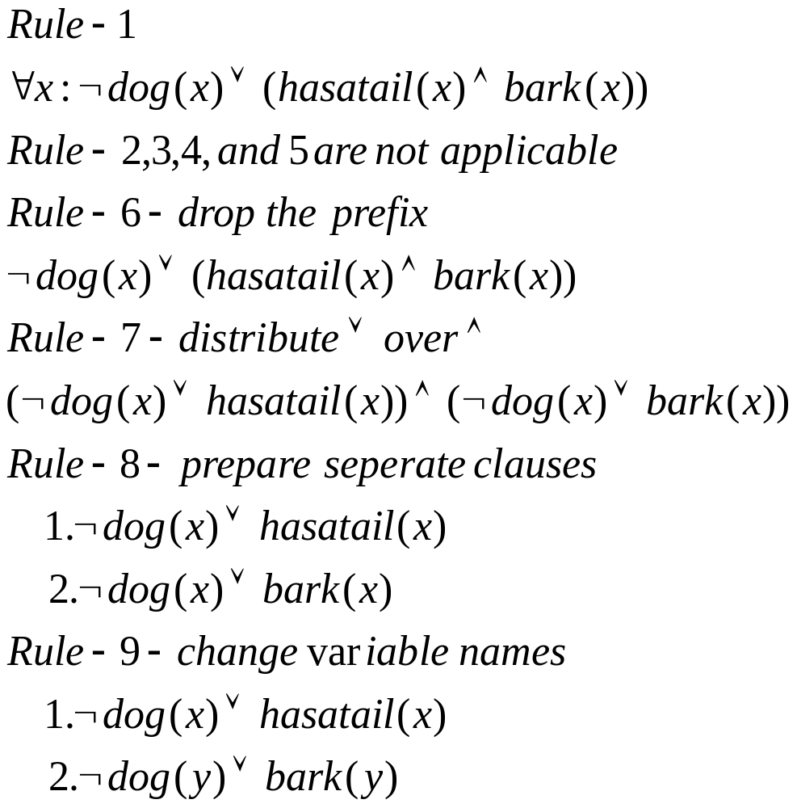

Slide 62
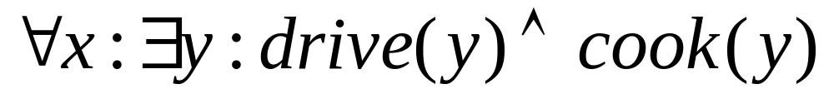
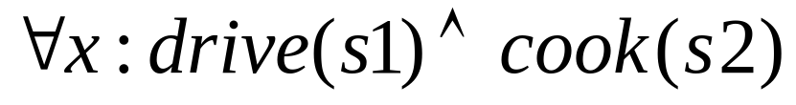
Problem.2
Convert following WFF into clause form
Rule 1 ,2 , 3 4 are not applicable
Rule 5- Eliminate Existential quantifiers by “Skolem functions”
S1 and s2 are “Skolem functions” and they correctly return value of x to satisfy the predicate.

Slide 63

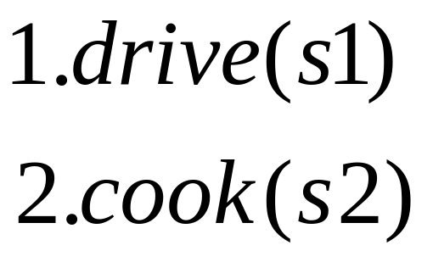
Rule-6:- drop the prefix
Rule-7-not applicable since it is already in CNF
Rule-8- creating separate clauses from each conjunct
Rule-9- Assuming that s1 will refer to x and s2 to y.

Slide 64
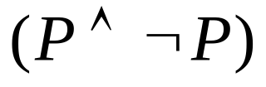

Resolution
It is a proof generating procedure.
It generates proof by “Contradiction”.
Definitions.
Contradiction:- is a statement whose every possible interpretation is “False” e.g
2.Tautology:- is a statement whose every possible interpretation is “True” e.g
3. Contingency:- is a statement which is neither tautology nor contradiction.

Slide 65
Resolution
Resolution generates proof by “Refutation”, means the fact to be proved is negated and then it is added to the knowledgebase and if a contradiction is found then original fact is proved.
¬
blue(sky)
blue(sky)
Red(carpet)
Contradiction is found in two ways.
Null resolvant
A non-null resolvant which is a contradiction.

Slide 66
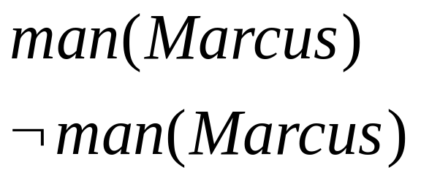
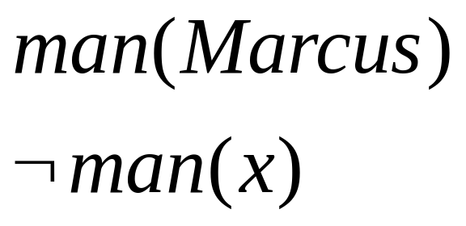
Unification
In resolution we can resolve/cancel following clauses in a straight forward manner.
Parent Clauses.
But we can not resolve/cancel following clauses in a straight forward manner unless x is replaced by Marcus.

Slide 67
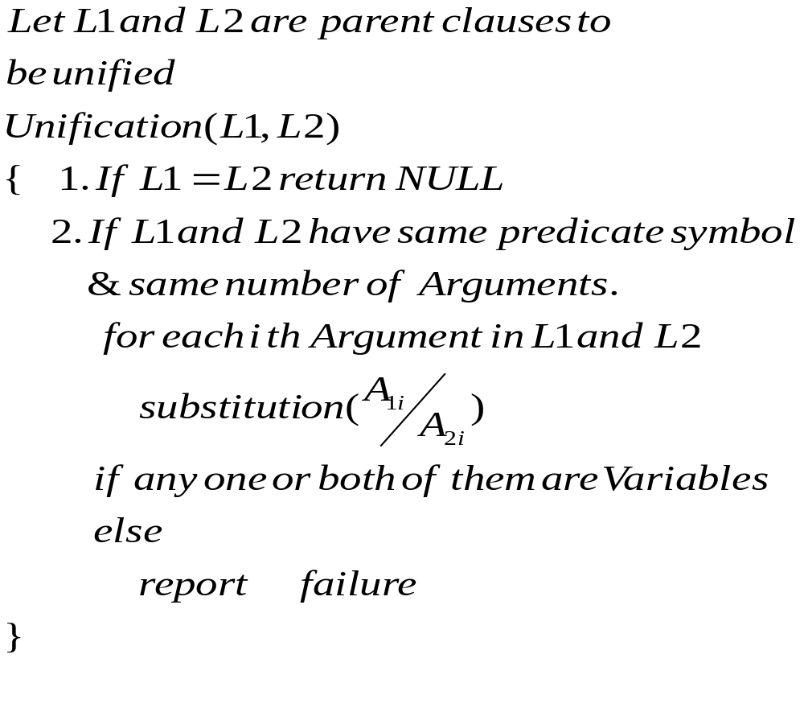
Unification
Unification is a process that suggest substitution to unify the parent clauses.

Slide 68
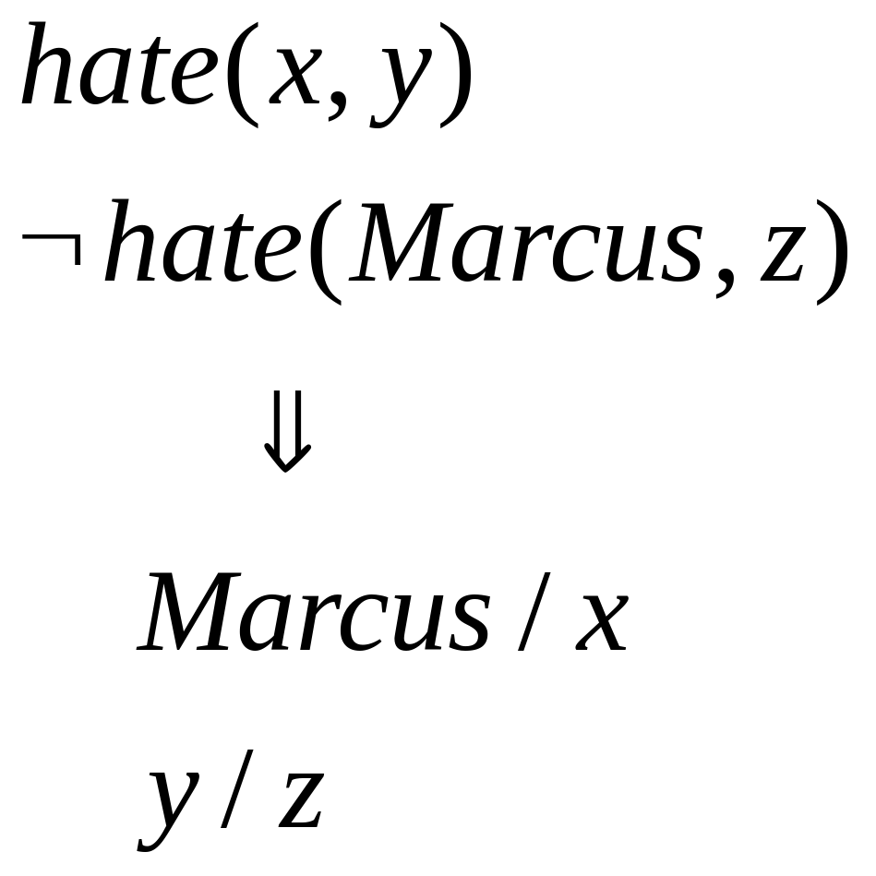
Example of unification
substitution

Slide 69
Problem-3.
Represent above facts in predicate logic and convert them into clause form.
Consider following facts about Santa Maria club.
1. Joe, Sally, Bill and Ellen are members of Santa
Maria club.
2. Joe is married to sally.
3. Bill is Ellen’s brother.
4. The spouse of every married person in the
club is also in the club.
5. Last meeting of the club was at Joe’s house.

Slide 70
Resolution
Consider set of facts F and a statement to be proved P.
Resolution Algorithm
Convert all the facts in F to clause form.
Negate P and convert the result to clause form. Add it to the set of clauses obtained in step 1.
Repeat until either a contradiction is found, no progress can be made or a predetermined amount of effort has been expanded.
  Select parent clauses.
  Resolve them together. If necessary call to unification to unify them. The resolvant will be disjunction of all the literal from both the clauses. Omit the resolved literals from the resolvant.

Slide 71
Resolution
c) If the resolvant is empty clause, then a contradiction has been found. If not then add it to the set of clauses available to the procedure. If can’t progress with non-null resolvant, check that is it a contradiction?

Slide 72
Guidelines to select clauses to speedup Resolution
Only resolve pairs of clauses that contain complementary literals.
Eliminate certain clauses as soon as they are generated so that they can not participate in later process.
Whenever possible resolve either with one of the clauses that is part of the statement to be proved or with a clause in resolvant. (set of support strategy)
Wherever possible resolve with a clause having single literal. Such resolution generates resolvant with fewer literals.( unit-preference strategy)

Slide 73
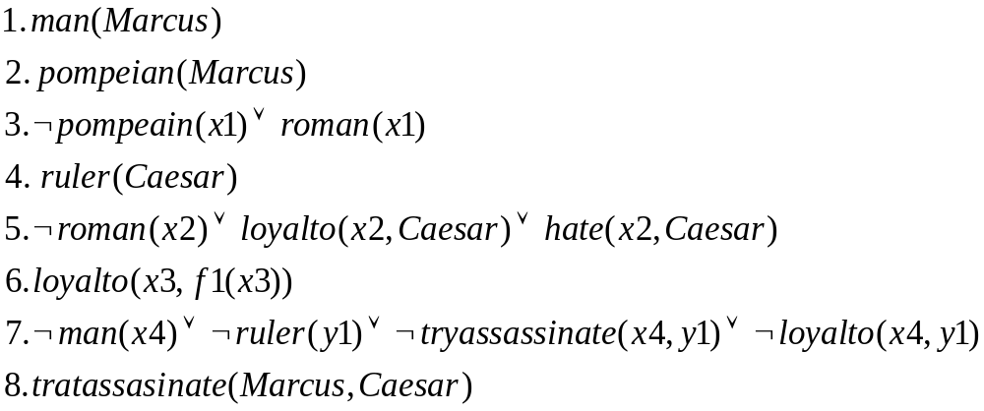
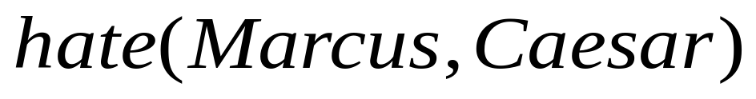
Example-1 of resolution.
F
This is a set of facts about the Marcus in clause form. Suppose we want to prove that “Marcus hate Caesar”.
P

Slide 74

Example-1 of resolution.
¬
5
Marcus/x2
3
Marcus/x1
2
7
Marcus/x4, Caesar/y1
1

Slide 75
4
8
Null
Since we found a Null resolvant, it means that contradiction has been found and thus “Marcus hate Caesar” is proved.

Slide 76
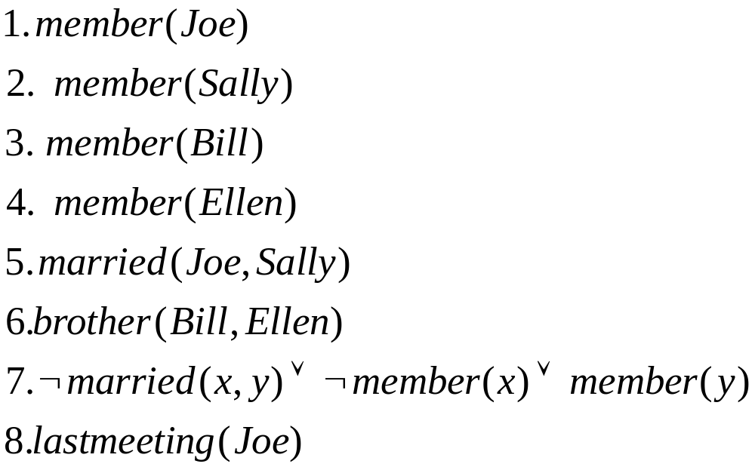
Example-2 of resolution.
Consider following facts about Santa Maria club.
1. Joe, Sally, Bill and Ellen are members of Santa Maria club.
2. Joe is married to sally.
3. Bill is Ellen’s brother.
4. The spouse of every married person in the club is also in the club.
5. Last meeting of the club was at Joe’s house.
Knowledgebase of about this club in Clause Form is as follows.

Slide 77

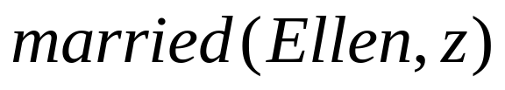



Suppose we want to prove that “Ellen is not married”
*****************************Resolution***************************
7
Ellen/x, z /y
4
Z can assume following values z=Joe, z=Sally, z=Bill
Since every possible interpretation of member(z) is False, Thus it is a contradiction.

Slide 78
Problem.1
Represent following facts in predicate logic and using resolution prove that West is a criminal.
1. It is crime for American to sell weapons to hostile nations.
2. Nono has some missiles.
3. All of missiles owned by Nono were sold to it by Colonel West.
4. Missiles are weapons.
5. America counts enemy as hostile.
6. West is American.
7. Country Nono is enemy of America.
Reference:- Artificial intelligence A modern approach-Russell & Norvig, Page.280

Slide 79

Facts in WFF

Slide 80
Facts in clause form

Slide 81

Null

Slide 82
Points to be learned
Forward and Backward reasoning , Forward and Backward chaining rules.
Reference:- Rich & Knight.

Slide 83
Introduction to Prolog
The name prolog was taken from phrase “PROgramming in LOGic” and first developed in 1972, in France.
It is unique in its ability to infer facts and conclusions
User has to provide a Knowledge Base (KB) about a problem domain and has to specify a goal. Then system uses KB to achieve this goal, defining its own procedure.
Procedural languages:-
  like C, C++, uses procedure describing how to solve a given problem?.
  Focus on Procedure and Data
  Same procedure is executed many times with great speed

Slide 84
Introduction to Prolog
Prolog Features
  OOP language
  No procedure and thus, no programs and thus no programmers, but “Knowledge Engineers”
  Only data (facts) about objects and their relationships
  Thus, a prolog program= database (Knowledge base)
  Goal is given by user and using formal reasoning it proves or disproves it for find truth value
  It is a complied language

Slide 85
Introduction to Prolog
Prolog software : This course recommends SWI prolog
SWI Prolog available on
[1]. http://www.swi-prolog.org/download/stable
Tutorials on
[2]. http://lpn.swi-prolog.org/lpnpage.php?pagetype=html&pageid=lpn-htmlse1
Learn:- Case study of Expert system from Rich and Knight (MYCIN OR PROSPECTOR)
Following are corresponding Lab Assignments
Lab assignment 4:- Implement real time applications in Prolog.
Uses Knowledge bases KB3 to KB5 and all the queries on them in [2]
Lab assignment 5:- Expert System in Prolog
Implement a small expert system in prolog for detection of childhood diseses
(refer:- Introduction to Turbo Prolog by Carl Townsend)

